Slide 1
Data Science/ Engineering
Overview and Architecture Implications

Slide 2
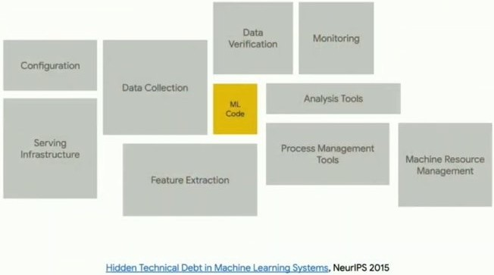
What does Arch/ Req have to do with it?
What does Architecture & Requirements have to do with DS or ML?
  research & uni project = data & models
  prod project = architecture & processes
Majority of DS / ML / AI projects fail
  cannot produce good results
    bad / not enough data
    no patterns to discover
  unreasonable expectations (requirements)
    e.g., build AGI
  unclear expectations (requirements)
    e.g., let’s play with an idea
  unclear / misaligned objectives (requirements)
    e.g., fraud detection with a lot of false positives

Slide 3
What does Arch/ Req have to do with it?
Majority of DS / ML / AI projects fail
  lack of domain understanding (requirements)
    e.g., “average transaction amount” feature – seasons?
  bad data governance (req & arch)
    e.g., “active user” – different meanings for diff teams
    e.g., mismatching ids
  bad data pipelines (architecture)
    e.g., non-idempotent jobs => unreproducible results
  inability to productionize models (arch)
    e.g., model drift
    e.g., accuracy monitoring & observability
    e.g., delayed data updates
    e.g., uncoordinated data updates (across sources)
    e.g., inference speed (infra, distrib infra, model optimiz.)
    e.g., scalability & price
    etc

Slide 4
What does Arch/ Req have to do with it?
Need to understand
  data ingestion
    data source integrations, streams, batches
    e.g., lambda-architecture, kappa-architecture
  data storage
    data warehouse, data lake, data marts
  feature engineering
    data cleaning / normalization, feature analysis / selection / construction
    real-time vs batch processing
  model training
    local GPUs, cloud, distributed system
    trust & security (federated learning)
  model serving
    hosting, scaling, network, protocols
Need to understand
  Monitoring & feedback loop
    accuracy, precision, recall, F1 score, AOC / ROC, confusion, etc
    model drift
    retraining pipelines
Engine vs Car

Slide 5
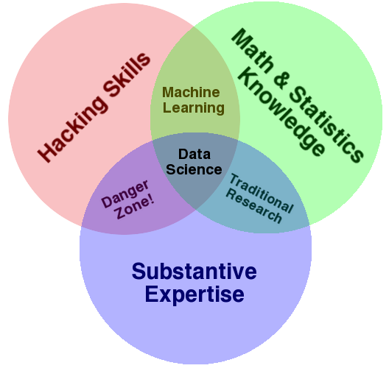
What is Data Science?
Finding patterns / insights in unstructured data
Demand data / predictions
  DS, 2023 -> 2033: grow by 36% (DoL)
    Danger – automation (just DS is not enough)
  AI/ML Eng, 2024->2025: grew by 89% (public analytics)
    Danger – the same (AutoML)
  MLOps, no reliable data: very new
Drew Conway: Dev skills + Math / Stats + Domain Expertise = Data Science
The Data Science Venn Diagram — Drew Conway

Slide 6
Data Science Projects
It’s rare (and usually unwise) to have one person do it all on anything other than a small project
Multi-disciplinary team are usually pulled together
Roles/ Team
  Data Engineers: data collecting, data pipelines, data preprocessing implementation, infra
    Architecture – design & create data flows
  Researchers: domain specific specialist (biologist, doctors, physicists) with stats skills
    Requirements – meet them
  ML Engineers: prod ML/AI algo implementation & optimization
    Req & arch – take a req-based model & fit into the arch
  Analysts: insight extraction, analytics, visualization, need domain knowledge
    Req – extract according to reqs & present results
  Business/ Project lead: Data+ML+SE+Business skills

Slide 7
Why do we need data?
Data is new gold
Insights
  evidence-based decisions
  => business competitive advantage
  e.g., Netflix -> recommendation -> retention
Data sources (not just DBs):
  social network data (graphs / connections)
    e.g., your friends’ purchases predict your purchases better than yours
    e.g., find strategic nodes -> seed content to them
    e.g., instead of credit score (Africa, Asia)
  Images (pictures)
    e.g., metadata, geolocation, object recognition
Data sources (not just DBs):
  Streaming data (video)
    What is watched / skipped / abandoned / replayed
    => recommendations
    Buffering rate / latency / resolution shifts / dropped frames
    => anticipate load peaks => scale the infra / switch routing
    Chat / audience mood analysis
    => real-time hints for streamers / commentators / speakers

Slide 8
Types of analytics
Descriptive (what is going on)
  Uses: plots, dashboards, summary stats
  Humans draw conclusions from the information
  e.g.,
    sales dashboard -> low sales -> what to do
Predictive (if-then or likely outcome based on data)
  Uses: statistics / ML
  e.g.,
    health predictions (if your will continue, then…)
    recommendation engines (we think you will like this)
Prescriptive (beyond prediction – recommended actions to achieve smt)
  e.g.,
    start medication now to prevent a stroke
    reroute trucks to minimize delays
Notes:
Regression is a common way to use understandable math/ data for predictive

Slide 9
Basic steps
  Get data
    DBs, APIs, logs, sensors, images, etc
  Clean data
    Remove duplicates, handle missing values, normalize formats, etc
    Often 80% of project time spend on cleaning data
  Explore data (visualize, understand, experiment)
    Understand outliers, skewed distributions, etc
  Iterate to clean data again
    Based on exploration results
  Model the data (can you abstract the data)
    Regression / classification / DL / etc
    Validate the model (iterate) / hyperparameter tuning

Slide 10
Tools we use
  Python / R / (Julia): Modeling and data manipulation
  C/C++: Fast backend processing
  DBs: SQL
Math: Probability, regression, linear algebra, calculus
Which math to use to process data

Slide 11
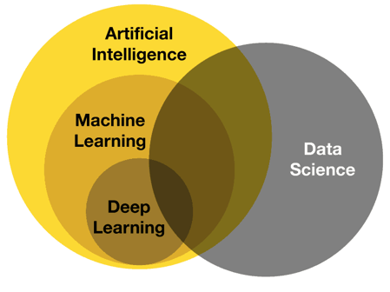
AI vs. ML vs. Data Science vs Engineering
Machine Learning - math
  Supervised learning – learn from labeled data
    Regression – predict values
    Classification – predict a class
    Ranking – sort by relevance
  Unsupervised learning – learn patterns without labels
    Clustering – group item by hidden similarities
    Anomaly detection – find unusual cases
  Reinforcement learning – learn by try & trial
    Reward for success – try to find a solution
  Time-series analysis
  Recommender systems
  etc

Slide 12
AI vs. ML vs. Data Science vs Engineering
Deep Learning – neural networks
  Feedforward Neural Networks – classic
    Universal approximator
  Convolutional Neural Networks – spatial patterns (images)
    Object detection / classification / etc
  Recurrent Neural Networks – sequential data
    Dependencies in a series (e.g., Google Translate before transformers)
  Transformers – attention-based sequences
    Find the most important parts
    Context window processing
  Generative DL – generate new information
    Various subtypes & nuances (e.g., ChatGPT, Midjourney)
  etc (specialized subtopics)

Slide 13
AI vs. ML vs. Data Science vs Engineering
Data Science
  Main focus – insight extraction
  Other view – whole lifecycle for anything about data
  Overlaps with AI/ML/Dl
    Sometimes same methods and goals
Artificial Intelligence – huge umbrella
  ML, DL, NLP, CV, Robotics, multi-agent systems, etc
Data Engineering
  Data infrastructure building & maintaining
  Supports all other areas

Slide 14
Training process (supervised)
  Dataset (point – label / value)
  Split into training, validation & test
    Training – with answers
    Validation – to check accuracy after each iteration
    Test – final test, unused in training process
  Initiate a model randomly
  Repeat for each datapoint
    Send a data point & compare a produced output with a correct label
    Adjust internal parameters to minimize difference with the expected result
  Use validation set to check if the result improving (or hyperparameter tuning)
    Overfitting / minimal gain – stop conditions
  Repeat

Slide 15
Arch impacts
  How to organize data
    e.g., data warehouse vs data lake, data marts?
  Data pipelines to move & transform data
    What ‘type’ of data? Image? Text? Smt else?
    How much data?
    What throughput & latency are needed?
    Parallel or serial processing?
    Streaming vs batch processing?
  Tool selection
    C/C++ / Java/C# / Python
  Algorithm swap
    Must support model change
  Distributed system or single system?
  If distributed,
    Communications?
    Synchronization?
  Lifecycle flexibility
    Can we swap technologies on all steps?
  Ways to present data
    Dashboards, APIs, mobile app?
    Real time updates?
  Automation

Slide 16
Data Science/ Architecture … not so different
Data Science /ML
Architecture
Collect data
Explore data
Prepare data
Model
Evaluate
Collect requirements
Review/ refine requirements
Generate options for architecture
Model or prototype options
Evaluate

Slide 17
Data Cleaning
Data anomalies are common in Data Science
Often, data is imported from multiple sources – and over time (so things change). Issues include:
Missing data
Incomplete Data
Duplicate data
Incorrectly formatted data
Inconsistent data
Outlier data
Sometimes it just that the data is not in a format or structure that makes it easy to analyse!
Data Engineering will use tools to uncover issues and correct them

Slide 18
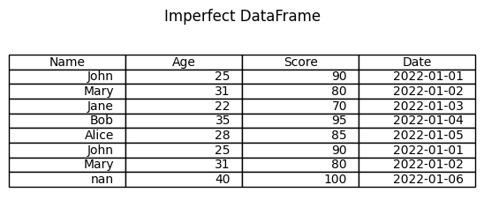
Example
Duplicates? (John)
Date Format? (Time? MM/DD or DD/MM)
Outliers? (100)
Missing? (nan = Nan or NaN?)

Slide 19
Tools
numpy
pandas
matplotlib
General tools
regex
scripts

Slide 20
Analysis
While descriptive analysis is a common starting point (using charts to show the nature of the data), a more advanced approach is predictive analysis
Descriptive: What is
Predictive: What might be
We’ll consider a basic predictive mechanism called ‘regression’
Think back to high school math ☺

Slide 21
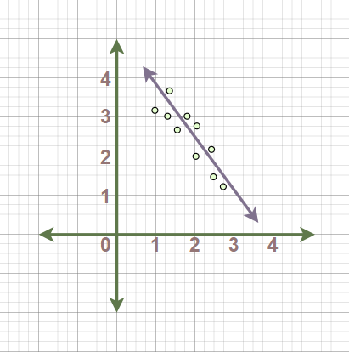
Linear regression
You may also recognize this as ‘line of best fit’
Essentially a line that minimizes variance between each data point
By establishing a regression line (best fit), any new data point (x) can have a predicted outcome (y)
X: Independent Variable
Y: Dependent Variable
matplotlib, sklearn are popular python libraries to help
Visualization of Linear Regression

